Slide 1


Spectral Efficiency of MU-Massive MIMO System for Perfect and Imperfect CSI Condition
Ika Rohmatul Aini, Puji Handayani
Electrical Dept. Institut Teknologi Sepuluh Nopember

Slide 2

GENERAL STRUCTURE
Introduction
What we proposed
Channel Model
System Model
Numerical Results
Conclusion

Slide 3
INTRODUCTION

Slide 4
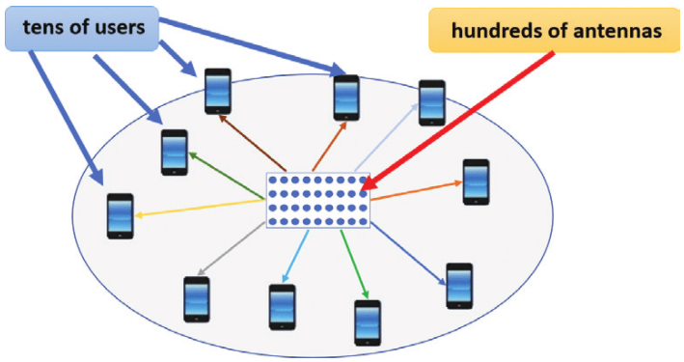
What is massive mimo
Massive MIMO sytem is a system that uses a large number of antenna on a BS and serves tens of users simultaneously.
The number of BS antennas can be a hundreds or even more.

Slide 5


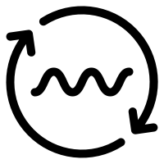
WHY MASSIVE MIMO
Massive MIMO is a promising candidate technology for the next wireless communication system
Massive MIMO system can increase spectral efficiency, energy efficiency and system reliability.
Simple signal processing techniques can be applied both at the BS and user side

Slide 6
what we proposed
Channel estimation process will be very complex because it is proportional to the large number of BS antennas
Some previous research on Massive MIMO system assumed perfect CSI condition on both the BS and the user side.
In practical, there is no perfect CSI condition, because the BS needs to estimate the channel response at certain coherence interval.
This research focus to investigate:
Spectral efficiency of Massive MIMO on perfect and imperferct CSI condition under Frequency-selective Rayleigh and UR-LOS channel model
MUI eliminination using linier precoding techniques, such as MRT, ZF and MMSE

Slide 7
CHANNEL MODEL

Slide 8
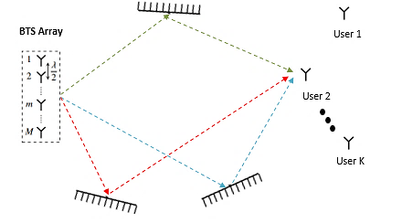
FREQUENCY-SELECTIVE RAYLEIGH
There are many scatterers and there is no line of sight path.
Consist of L tapped-delay line channel.
Power Delay Profile (PDP) at each tapped-delay line has negative exoponential distribution.

Slide 9
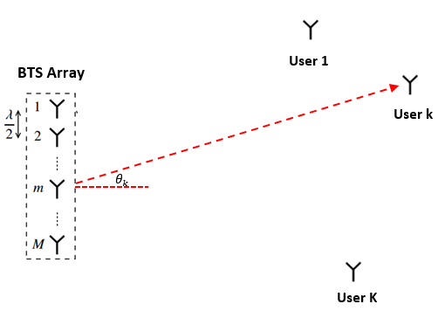
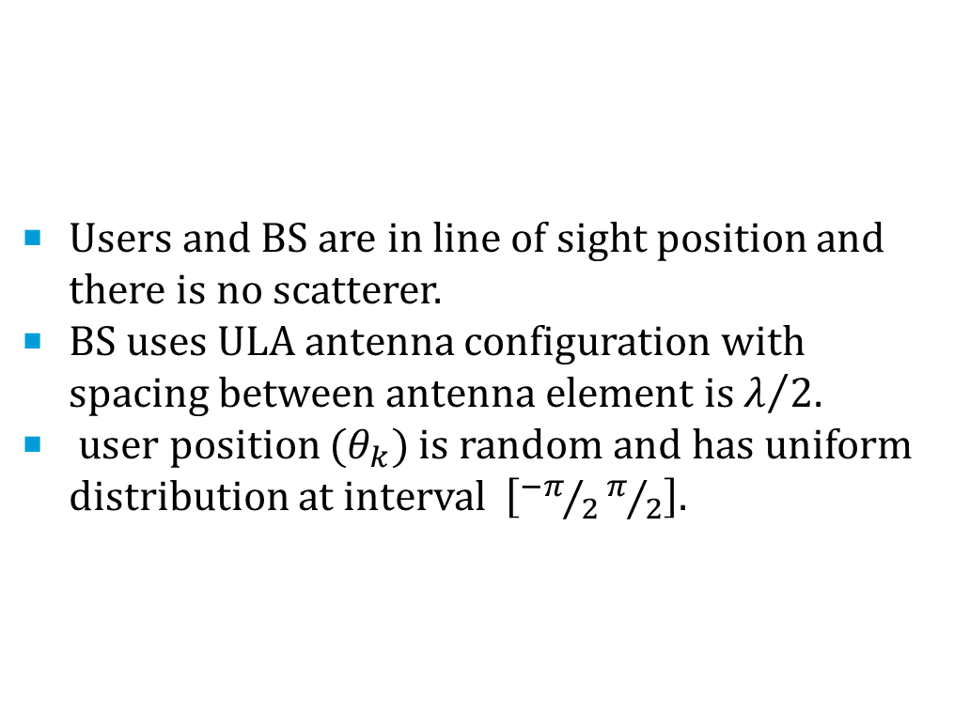
UNIFORMLY RANDOM LINE OF SIGHT (UR-LOS)
Users and BS are in line of sight position and there is no scatterer.
BS uses ULA antenna configuration with spacing between antenna element is $λ/2$.
user position ${(θ}_{k})$ is random and has uniform distribution at interval $\left[{−π}/2π/2\right].$

Slide 10
SYSTEM MODEL

Slide 11
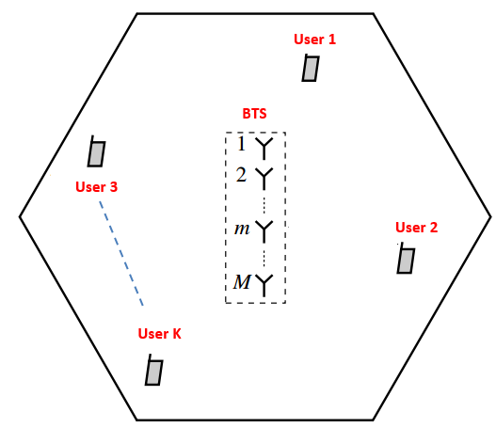
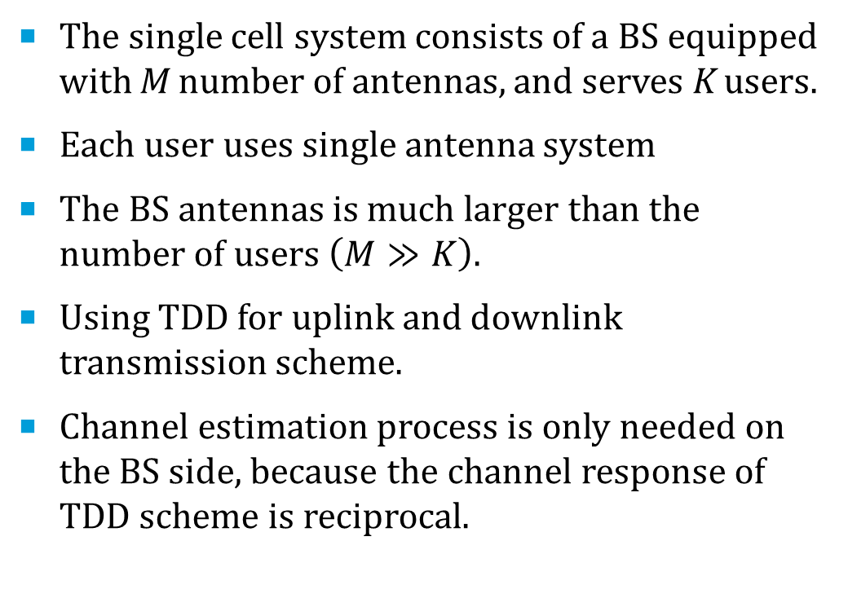
SYSTEM MODEL
The single cell system consists of a BS equipped with M number of antennas, and serves K users.
Each user uses single antenna system
The BS antennas is much larger than the number of users $\left(M≫K\right)$.
Using TDD for uplink and downlink transmission scheme.
Channel estimation process is only needed on the BS side, because the channel response of TDD scheme is reciprocal.

Slide 12
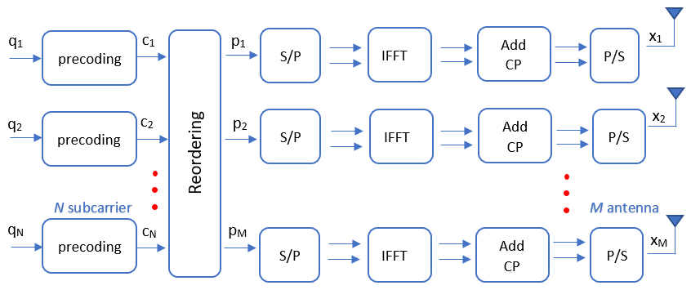
Sistem pemancar (bts)
BS Side

Slide 13
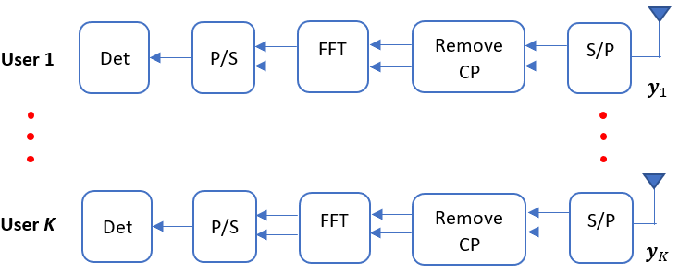
User Side

Slide 14
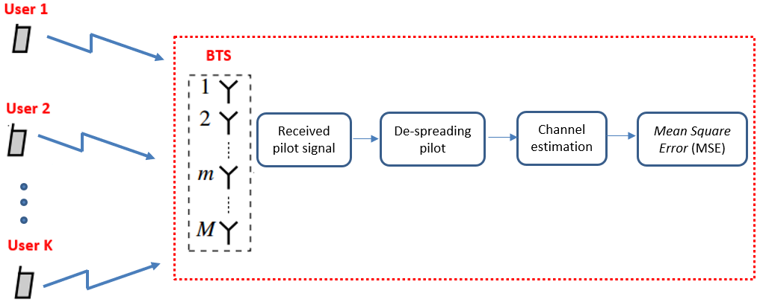
Channel estimation
Each user transmits orthogonal pilot signal to the BS at each coherence interval.
The transmitted pilot is a unitary matrix which is known at both ends of the link
BS performs de-spreading pilot signal by multiplying pilot signal with unitary marix
BS estimates the channel response using Minimum Mean Square Error (MMSE) techniques.

Slide 15
NUMERICAL RESULTS

Slide 16
Bit error rate ON THE FREQ- SELECTIVE RAYLEIGH CHANNEL
BER of Singe Input Single Output (SISO) and Single User Massive MIMO
SISO system:
M = 1, K = 1
Single user Massive MIMO system:
M = 100, K = 1
Overall, BER of Massive MIMO system is lower than SISO.
All of precoding schemes yield the same BER, because there is no multiuser interference.

Slide 17
Bit error rate ON THE FREQ- SELECTIVE RAYLEIGH CHANNEL (CONT…)
BER of Singe Input Single Output (SISO) and Multi User Massive MIMO
Several users which are served simultaneously will cause multiuser interference.
All precoding schemes have different performance due to the effects of multiuser interference.
For MU Massive MIMO system, ZF and MMSE yield the lower BER than MRT.

Slide 18
Bit error rate ON THE UR-LOS CHANNEL
The user position is in the line of sight to the BS.
All precoding scheme provide same BER under the UR-LOS channel.
Overall, BER in UR-LOS channel is lower than Rayleigh channel.

Slide 19
SPECTRAL EFFICIENCY OF MU-MASSIVE MIMO ON PERFECT CSI CONDITION
K = 30 users, SNR = 10dB
There is no channel estimation process in BS.
BS is fully knowing the channel information without any noise and pilot contamination effects.
At high SNR, ZF and MMSE precoding yield the same spectral efficiency both at Rayleigh and UR-LOS channel.
ZF and MMSE precoding is better at minimizing multiuser interference than MRT.
Spectral efficiency at UR-LOS channel is higher than Rayleigh.

Slide 20
SPECTRAL EFFICIENCY OF MU-MASSIVE MIMO ON PERFECT CSI CONDITION (CONT…)
K = 30 users, SNR = 0dB.
The overall system performance will decrease if the downlink SNR decreases.
At low downlink SNR, MMSE precoding works better than ZF and MRT.
MMSE not only minimizes multiuser interference properly, but also increase SINR on the user's side,

Slide 21
SPECTRAL EFFICIENCY OF MU-MASSIVE MIMO ON imPERFECT CSI CONDITION
K = 30 users.
Downlink SNR =10dB, uplink SNR = -5 dB.
The total number of pilots transmitted by each user must be greater or equal to the number of active users in a cell.
Each user transmit a minimum number of pilot sequences, which are 30 symbols.
BS estimates channel response from pilot signal transmitted by users through uplink channel.
The spectral efficiency of imperfect CSI condition is lower than perfect CSI condition due to the channel estimation error.

Slide 22
Mean square error of channel estimation
Channel estimation error really depends on uplink SNR at the BS
The higher the uplink SNR, the channel estimation error will be smaller
At low uplink SNR region, MSE of UR-LOS channel is lower than Rayleigh channel.
MSE of these two channel conditions has the same value when the uplink SNR is above 0 dB.

Slide 23
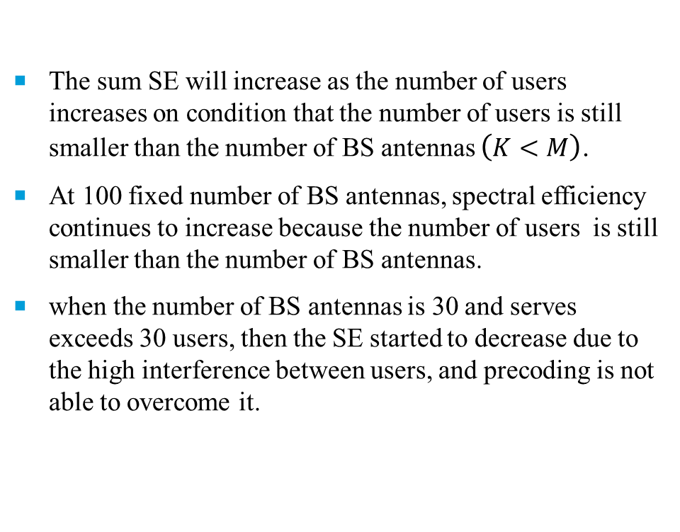
Spectral efficiency vs. number of users
The sum SE will increase as the number of users increases on condition that the number of users is still smaller than the number of BS antennas $\left(K<M\right)$.
At 100 fixed number of BS antennas, spectral efficiency continues to increase because the number of users is still smaller than the number of BS antennas.
when the number of BS antennas is 30 and serves exceeds 30 users, then the SE started to decrease due to the high interference between users, and precoding is not able to overcome it.

Slide 24
conclusion
The spectral efficiency increases significantly as the number of BS antennas increases.
ZF and MMSE precoding work better than MRT precoding in miminizing MUI.
Under imperfect CSI condition, channel estimation error is getting bigger at low uplink SNR, so that the spectral efficiency will decrease.
The spectral efficiency of each user will decrease if the number of users increases, because the MUI is getting bigger.

